Slide 1
Building an in-house Accessibility Team
Sheri Byrne-Haber (she/her/hers)
Senior Staff Accessibility Architect, OCTO

Slide 2
Agenda
Introduction
    What is disability and accessibility?
    Why should everyone care?
  How did VMware start its accessibility journey
  What all organizations can do to increase disability inclusion

Slide 3
Introduction

Slide 4
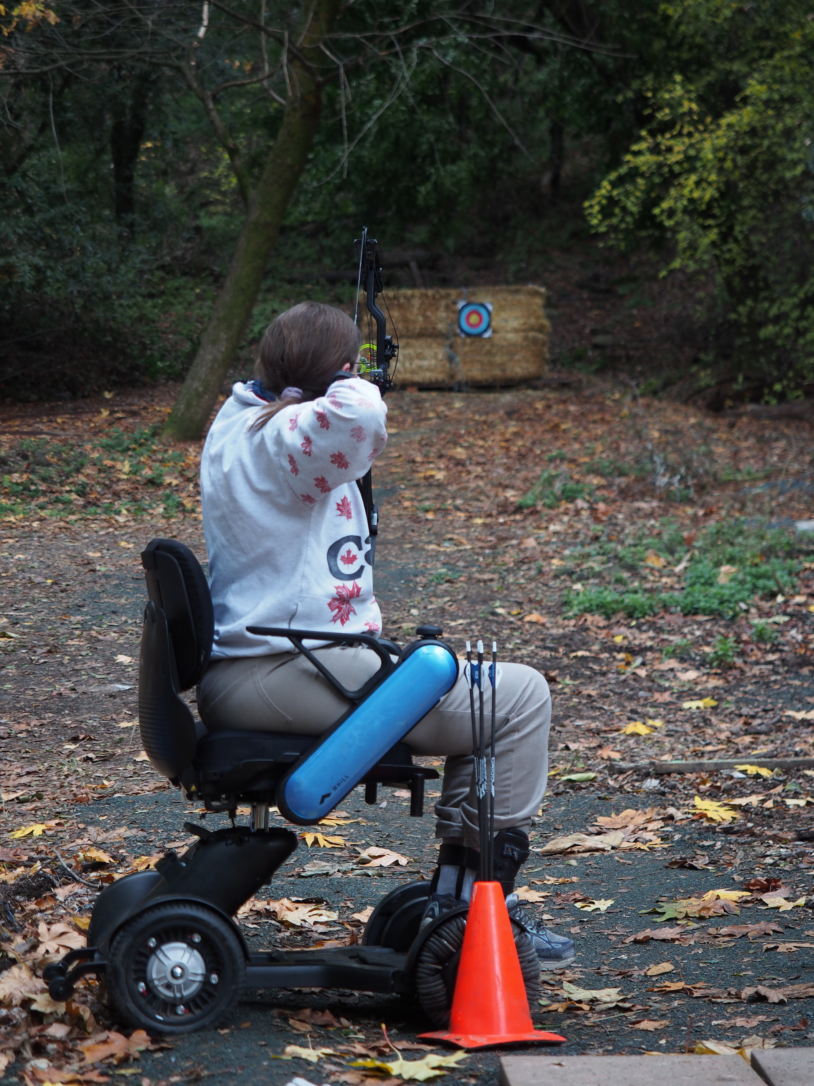
Who am I?
Multi-disciplinary background
Medium 2020 UX Collective Author of the Year
Founder of VMware Accessibility program
Co-founder of the Disability @ VMware employee resource group
Magnification and keyboard only user with a deaf daughter

Slide 5
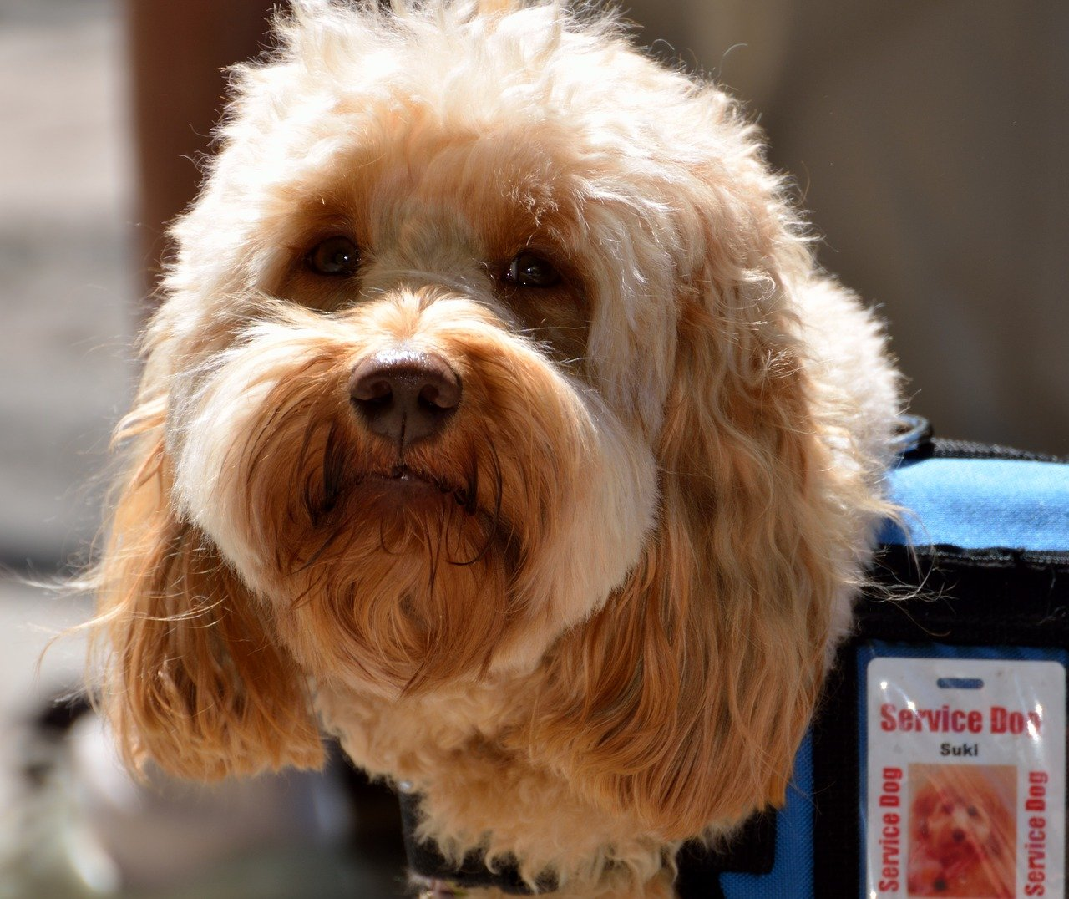
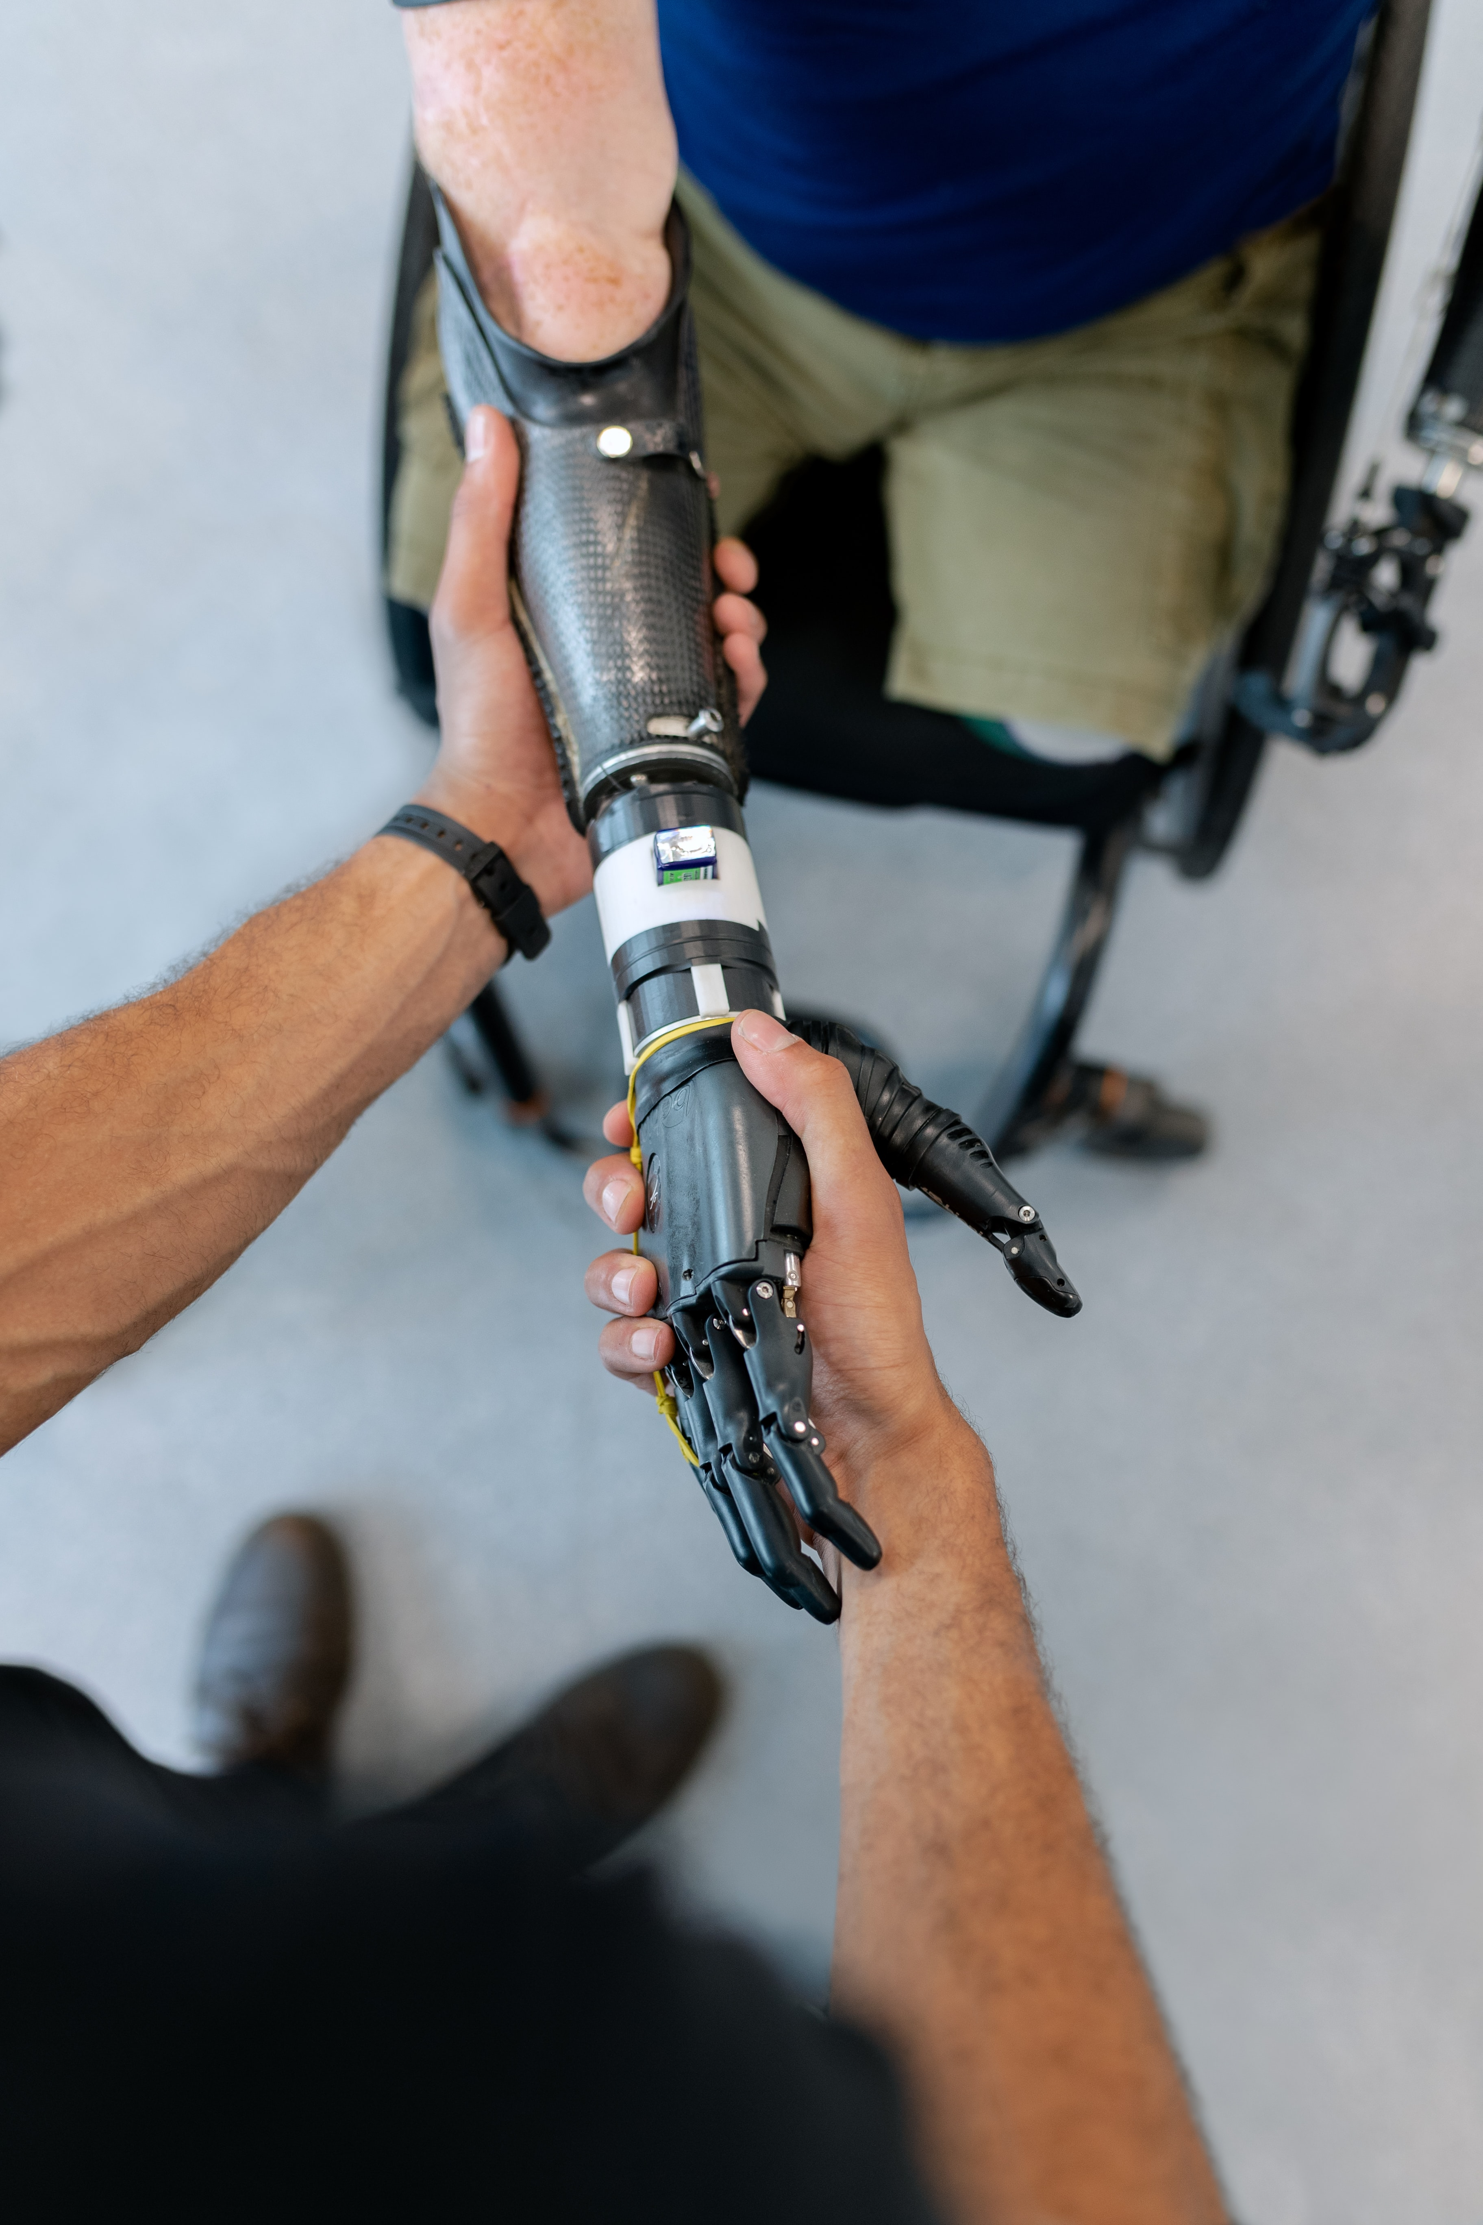
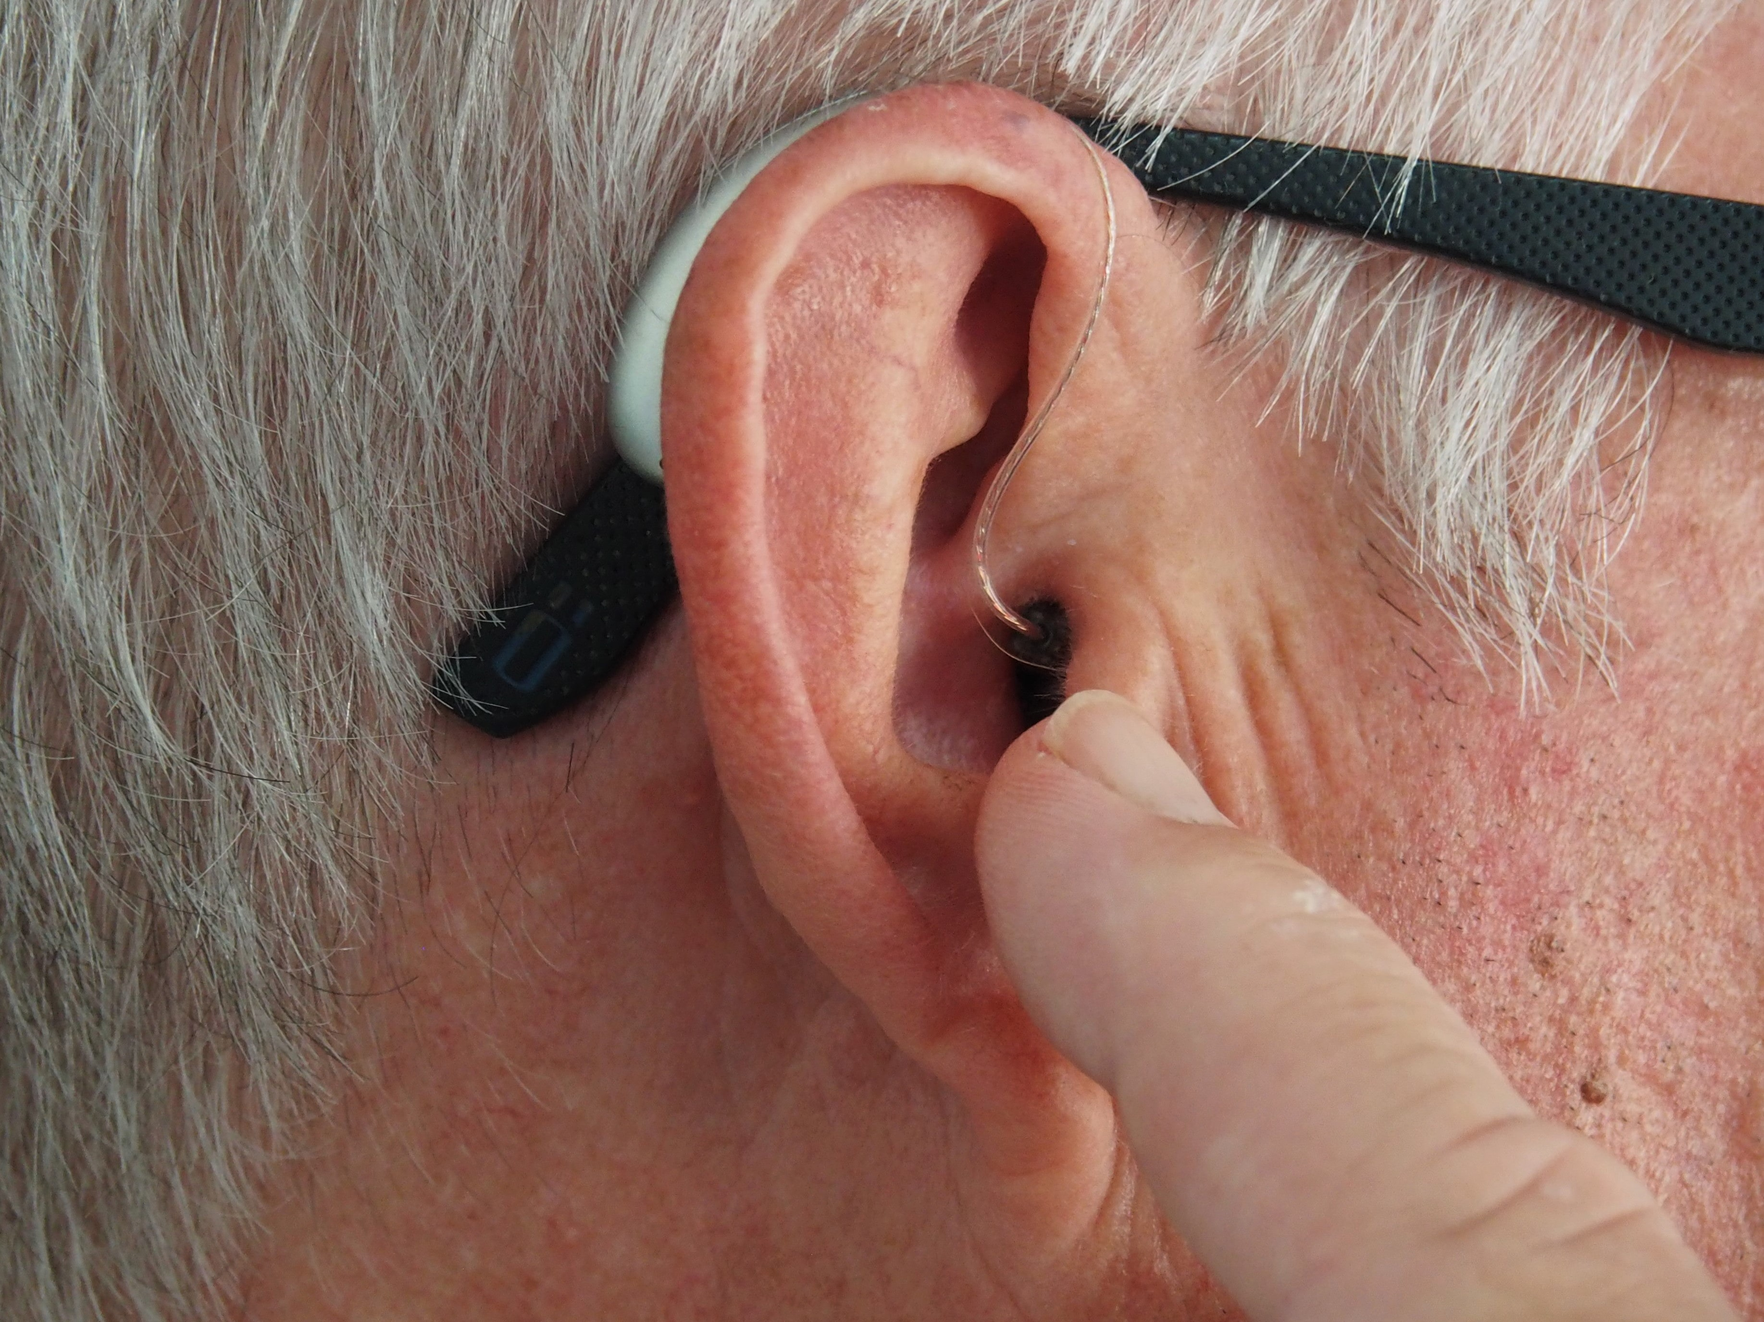
Accessibility is about Visible Disabilities

Slide 6


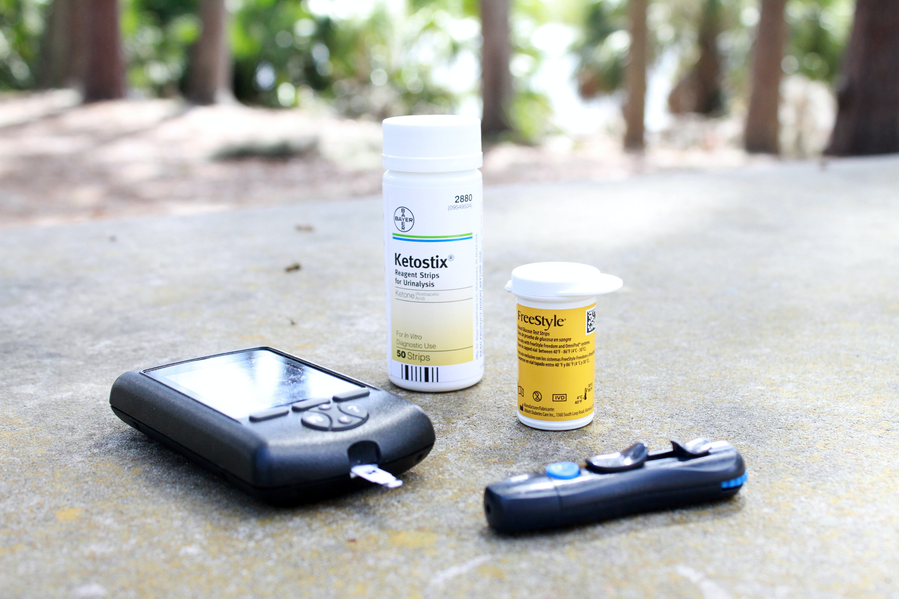


Accessibility is also about Hidden Disabilities

Slide 7
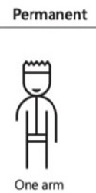
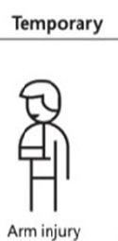
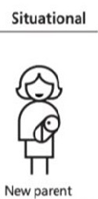
Accessibility is also about temporary and situational ability loss
Permanent
Temporary
Situational
Limb Difference
Limb Difference
Shoulder Injury
Holding Something
From the Microsoft Inclusive Design Toolkit Accessibility Persona Spectrum
Notes:
So far, all we’ve talked about is permanent disabilities. A limb difference is a permanent disability. But there are also temporary and situational impairments that act a whole lot like permanent disabilities, but they are for a shorter period of time until the event that caused them is over
So one temporary version of a missing arm might be a rotator cuff tear
18 % of the current US population identifies as having a disability. The majority of these disabled individuals – 9.5 % - are working age people between the age of 18 and 65. The US government goal for employment of people with disabilities is 7 %. There is only one large company in the US meeting that goal. To have 7 % of your employees have a disability means you need one in every 30 people with a visible disability and one in every 15 people willing to talk about a hidden disability.
The unemployment rate in the US pre-COVID 19 for people with disabilities was 2 ½ times the unemployment rate for people without disabilities. One of the reasons for that is people with disabilities can’t get jobs where the software
(use an info graphic – check out Canva)

Slide 8
Why should everyone care?
18
8
92
The % of PwDs who will head to a more accessible competitor without telling you if they can’t use your website or products.
The % of US population who identifies on the census as having one or more disability/ies
The amount People with Disabilities (PwDs) spend in TRILLIONS globally.

Slide 9
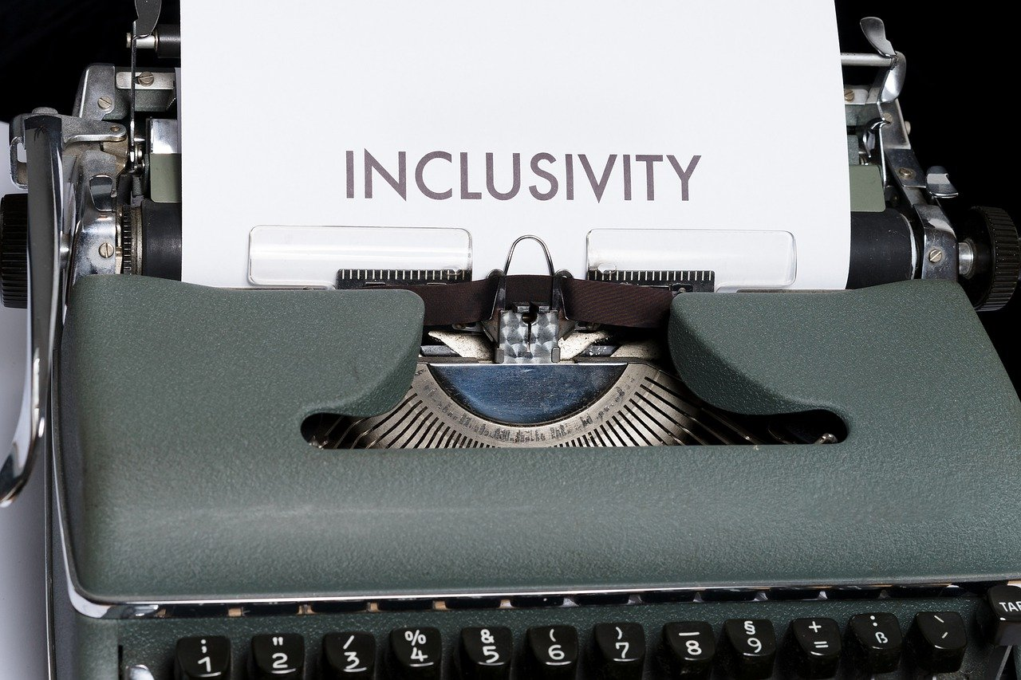
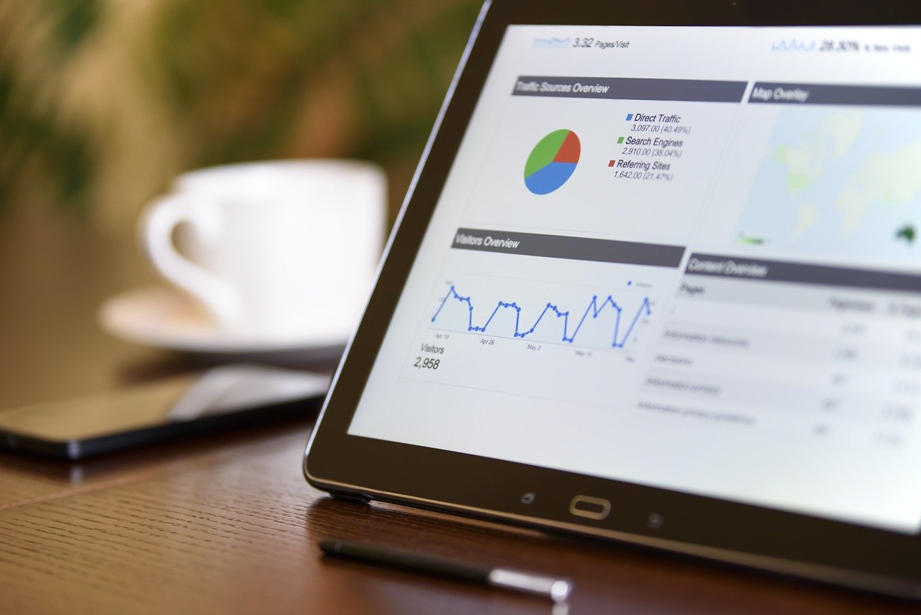

Three reasons to be disability inclusive

Slide 10
Why start with inclusion?
Currently, millennials make up more than one-third of the US workforce.
Millennials feel very strongly about inclusion with respect to employment
Millennials feel *especially* strongly about inclusion with respect to how an employer treats employees who identify as Neurodiverse.
  20 % said they have decided against applying for a job because they didn’t see evidence the employer was neurodiversity inclusive.
  80 % said they would feel more positive about an employer that did put out public info about their neurodiversity inclusion.

Slide 11
Business and Law are starting to overlap
Accessibility is no longer a competitive advantage, it is an expectation.
Four EU countries have banned the public sector acquiring inaccessible software
  Regulations will get stronger in 2025 when the European Accessibility Act takes effect.
Two US states have accessibility laws
Canada, the UK, Australia and Israel have accessibility laws.
Private litigation in the US is through the roof.

Slide 12
Choose your standard
Web Content Accessibility Guidelines (WCAG)
World Wide Web Consortium (W3C)
3 Increasing levels of compliance
  2.0 released 2009
  2.1 released June 2018
  2.2 coming Nov 2021
  3.0 coming ~2024
  A, AA, AAA (AAA is strictest)
  Most regulations and courts have settled on AA
    US Public Sector sales decided on 2.0 AA July 2018
    EU, settlement agreements and other countries use 2.1

Slide 13

Step 1: Disability Employee Resource Group
A diverse team representing diverse needs
VISION
Embrace and empower everyone with access for all
MISSION
Drive true inclusion for people of all abilities by creating a VMware that encourages self-identification and enablement
POWER OF DIFFERENCE
INCLUDES
Disability@VMware
Visible and Invisible disabilities,
Neurodiversity, Mental Wellness

Slide 14

Step 2: Build digital inventory
Where we actually were
…
wasn’t where we thought we were

Slide 15

Step 3: Executive support

Slide 16

Step 4: Budget

Slide 17
Step 5: How do you staff your accessibility effort
Staff
Contractors (evergreen)
Contractors (project)
Crowdsourced

Slide 18

Step 5: Training and champions program

Slide 19
Step 6: Hire employees with disabilities everywhere, not just on the DEI or Accessibility teams
Hiring more employees with disabilities required overhauling:
Talent Acquisition
Interview process
Accommodations
Offers
Onboarding
Retention programs
One year after the POD was launched and the initial accessibility team was hired, VMware’s US self-identification rate doubled

Slide 20
Step 7: Testing tools and Strategy
We built a state-of-the-art machine learning based automated accessibility testing tool
  Crest looks at data and patterns, not just code.
  We think we can move the needle from a 30/70 split between automated and manual testing to 50/50 in the next year.
Integrated into product CI/CD pipeline
Crest is downloadable for free from VMware’s Git repo.

Slide 21
Step 8: Internal accessibility policy
VMware not only wanted to be inclusive, we wanted to make disabled colleagues felt like they were wanted and belonged.
  Working with vendors to remediate the current tools
  While not continuing to add to VMware’s accessibility debt
When you choose to prioritize inclusion, the number of accommodations requests should drop substantially

Slide 22

Step 9: Product report cards

Slide 23
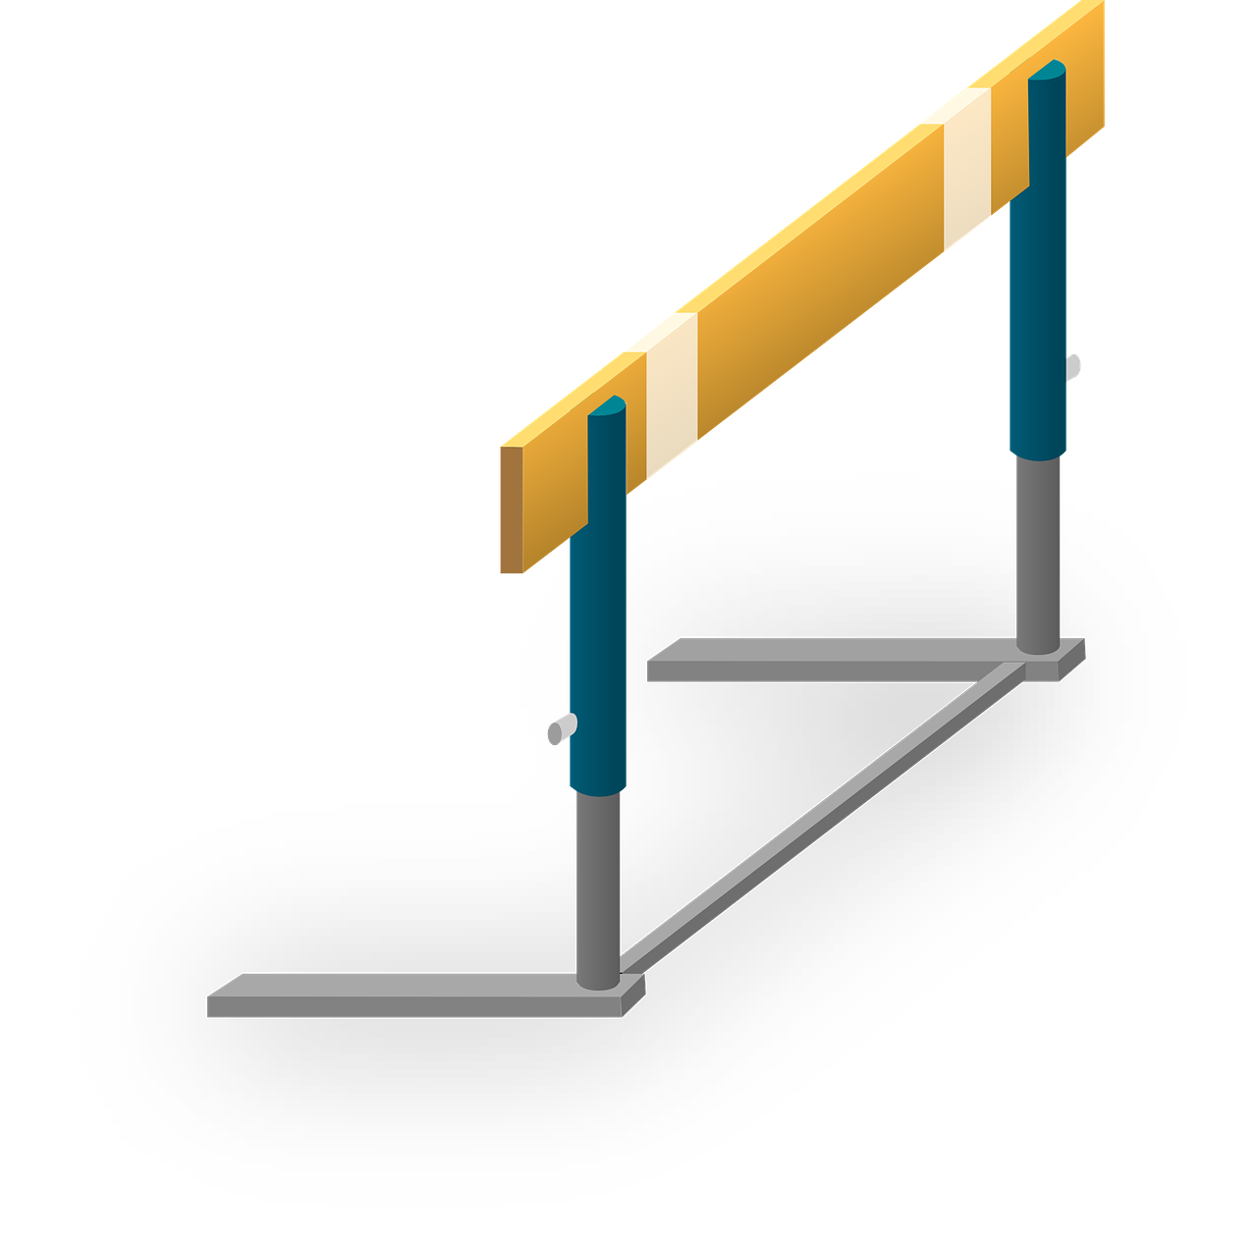
Step 10: Product release gates
Release Gate
Inaccessible
Accessible !!!

Slide 24
Building or amplifying an accessibility program

Slide 25
Know where you are starting from
Internally analyze your organization’s disability maturity
Disability:IN DEI Index
Business Disability Forum
Digital Accessibility Maturity Model
Coming soon: W3C Accessibility Maturity Model
Be honest
You only get out of it what you put into it

Slide 26
Start with the low hanging fruit
Captions
Presentation templates
Color choices
Accommodations process

Slide 27
More advanced steps
Explicitly call out disability as a regular dimension of your organization’s JEDI program
Start a disability ERG (if you don’t have one)
Get an executive sponsor for your accessibility program, preferably someone at the C-Suite level or connected to the products/IT
Build a training program
Hire a team - if you are already using outside consulting, build a permanent team to take over some of that work
Build an accessibility remediation roadmap
Execute the roadmap

Slide 28
Recap
Accessibility is part of every company’s mission, and every employee’s job.
Accessibility is a program, not a project
Accessibility isn’t just about what an organization sells, it’s about services, training, marketing materials, documentation, support and conferences.
Employees need accessibility just as much as customers do.
Use your influence to let vendors know that accessibility is important to your organization.

